Slide 1
Lecture-11

Slide 2
Contents
Software Development Life Cycle
SDLC Goals
SDLC Models
DevOps SDLC

Slide 3
Software Development Life Cycle
The Software Development Life Cycle (SDLC) is a structured process that enables the production of high-quality, low-cost software, in the shortest possible production time.
The SDLC process involves several distinct stages, including planning, analysis, design, building, testing, deployment and maintenance.

Slide 4
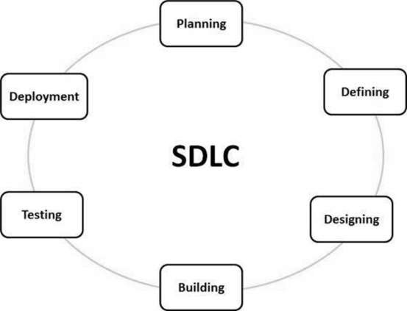
Software Development Life Cycle (Cont.)

Slide 5
Planning and Requirement Analysis
“What do we want?”
In this stage of the SDLC, the team determines the cost and resources required for implementing the analyzed requirements.
Requirement analysis is the most important and fundamental stage in SDLC.
It is performed by the senior members of the team with inputs from the customer, the sales department, market surveys and domain experts in the industry.

Slide 6
Defining Requirements
Once the requirement analysis is done the next step is to clearly define and document the product requirements and get them approved from the customer or the market analysts.
This is done through an SRS (Software Requirement Specification) document which consists of all the product requirements to be designed and developed during the project life cycle.

Slide 7
Designing
“How will we get what we want?”
This phase of the SDLC starts by turning the software specifications into a design plan called the Design Specification.
A design approach clearly defines all the architectural modules of the product along with its communication and data flow representation with the external and third party modules (if any). The internal design of all the modules of the proposed architecture should be clearly defined with the minutest of the details in DDS (Design Document Specification).

Slide 8
Building or Developing the Product
“Let’s create what we want.”
At this stage, the actual development starts. It’s important that every developer sticks to the agreed blueprint. Also, make sure you have proper guidelines in place about the code style and practices.

Slide 9
Testing the Product
“Did we get what we want?”
In this stage, we test for defects and deficiencies. We fix those issues until the product meets the original specifications.
In short, we want to verify if the code meets the defined requirements.

Slide 10
Installation / Deployment in the Market
“Let’s start using what we got.”
At this stage, the goal is to deploy the software to the production environment so users can start using the product. However, many organizations choose to move the product through different deployment environments such as a testing or staging environment.

Slide 11
Application Maintenance
“Let’s get this closer to what we want.”
Once the system is deployed, and customers start using the developed system, following 3 activities occur:
  Bug fixing – bugs are reported because of some scenarios which are not tested at all
  Upgrade – Upgrading the application to the newer versions of the Software
  Enhancement – Adding some new features into the existing software

Slide 12
SDLC Goals
The goal of the SDLC is to produce superior software that meets and exceeds all customer expectations and demands.
The SDLC defines and outlines a detailed plan with stages, or phases, that each encompass their own process and deliverables.

Slide 13
Software Development Life Cycle Models
  Agile
  Waterfall
  DevOps
  And so on…
Each of these approaches varies in some ways from the others, but all have a common purpose: to help teams deliver high-quality software as quickly and cost-effectively as possible.

Slide 14
Software Development Life Cycle Models (Cont.)
The waterfall or sequential model was a pioneering approach in the Software Development Life Cycle (SDLC).
With this model, software development becomes a linear process where different phases and tasks are positioned successively.

Slide 15
Software Development Life Cycle Models (Cont.)
Agile SDLC model is a combination of iterative and incremental process models with focus on process adaptability and customer satisfaction by rapid delivery of working software product.
Agile Methods break the product into small incremental builds.
These builds are provided in iterations.
Each iteration typically lasts from about one to three weeks.

Slide 16
Software Development Life Cycle Models (Cont.)
The Agile involves continuous iteration of development and testing in the SDLC process.
It can be implemented in many ways, such as Kanban, XP, Scrum, etc.
Every iteration involves cross functional teams working simultaneously on various areas like −
  Planning
  Requirements Analysis
  Design
  Coding
  Unit Testing and
  Acceptance Testing

Slide 17
DevOps SDLC
DevOps consists of multiple phases that collectively become the DevOps lifecycle.
  Continuous Development
  Continuous Integration
  Continuous Testing
  Continuous Feedback
  Continuous Monitoring
  Continuous Deployment
  Continuous Operations

Slide 18
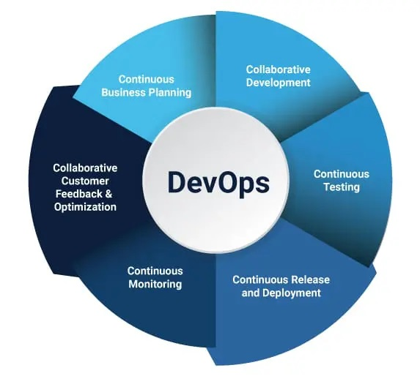
DevOps Lifecycle (Cont.)

Slide 19
DevOps Lifecycle (Cont.)
Continuous Development
  This phase involves the planning and coding of the software. The vision of the project is decided during the planning phase. And the developers begin developing the code for the application. There are no DevOps tools that are required for planning, but there are several tools for maintaining the code.

Slide 20
DevOps Lifecycle (Cont.)
Continuous Integration
  This phase involves the build and coding of the software. The code supporting new functionality is continuously integrated with the existing code. The updated code needs to be integrated continuously and smoothly with the systems to reflect changes to the end-users.
  Whenever there is a change in the Git repository, then Jenkins fetches the updated code and prepares a build of that code, which is an executable file in the form of war or jar. Then this build is forwarded to the test server or the production server.
  Jenkins is a popular tool used to automate this phase.

Slide 21
DevOps Lifecycle (Cont.)
Continuous Testing
  This phase, where the developed software is continuously testing for bugs. For constant testing, automation testing tools such as TestNG, JUnit, Selenium, etc are used. These tools allow QAs to test multiple code-bases thoroughly in parallel to ensure that there is no flaw in the functionality.

Slide 22
DevOps Lifecycle (Cont.)
Continuous Monitoring
  Monitoring is a phase that involves all the operational factors of the entire DevOps process, where important information about the use of the software is recorded and carefully processed to find out trends and identify problem areas. Usually, the monitoring is integrated within the operational capabilities of the software application.
  The system errors such as server not reachable, low memory, etc are resolved in this phase. It maintains the security and availability of the service.

Slide 23
DevOps Lifecycle (Cont.)
Continuous Feedback
  The application development is consistently improved by analyzing the results from the operations of the software. This is carried out by placing the critical phase of constant feedback between the operations and the development of the next version of the current software application.

Slide 24
DevOps Lifecycle (Cont.)
Continuous Deployment
  In this phase, the code is deployed to the production servers. Also, it is essential to ensure that the code is correctly used on all the servers.
  Here are some popular tools which are used in this phase, such as Chef, Puppet, Ansible, and SaltStack.

Slide 25
DevOps Lifecycle (Cont.)
Continuous Operations
  Its last phase where all DevOps operations are based on continuity with complete automation of the release process and allow the organization to accelerate the overall time to market continuingly.

Slide 26
Thanks
…?

